Slide 1
The basics of Bayes decision theory

Slide 2
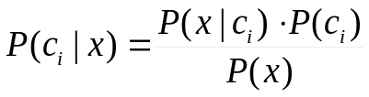
Statistical pattern recognition
The most popular approach to pattern classification
  It has a firm background in mathematics (statistics)
  It offers practically applicable solutions
It seeks to solve the classification task
  Objects to be classified→ feature vector x
  Goal: to map each object (feature vector) into one of the classes C={c₁,..,c_{M}}
Background in statistics (probability theory): we will estimate the joint (conditional) probability of X and C
  Bayes’ formula:
  P(c_{i}|x) : the a posteriori probability of the c_{i} class
  P(x|c_{i}) : the class-conditional distribution of the x feature vectors
  P(c_{i}) : the a priori distribution of the c_{i} class
  P(x) : it won’t be important for the optimal classification

Slide 3
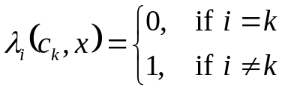
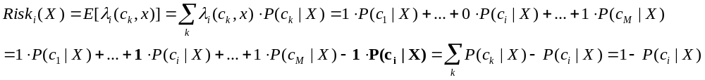
The Bayes decision rule
We seek to minimize: the number (rate) of misclassifications on the long run
  Formalization: Let’s introduce the 0-1 loss function λ_{i}(c_{k},x)
Bayes’ decision rule: the long-run rate of misclassifications will be minimal if for each input vector x we chose the class c_{i} for which P(c_{i}|x) is maximal
  Proof: we can formalize the error as the expected value of λ_{i}(c_{k},x)
  We also call it the risk of chosing class c_{i} :
  This will be minimal if P(c_{i}|x) is maximal
k: correct class
i: selected class

Slide 4

The Bayes decision rule 2
To calculate the global risk over all the feature space X we have to calculate
  Of course, if we minimize the risk for all x values (i.e. we make an optimal decision for all x), then the global risk will also be minimized at the same time
The Bayes’ decision rule is a special case of what we called the indirect or decision theoretic approach earlier:
  For each class c_{i} we create the discriminant function g_{i}(x)=P(c_{i}|x)
  We classify a test point x by selecting the class for which g_{i}(x) is maximal
Note: this approach may also by used with other discriminant functions
(e.g. using some heuristically selected functions). However, the proof guarantees optimality only for g_{i}(x)=P(c_{i}|x)
Using Bayes’ decision rule, the problem of classification boils down to estimating P(c_{i}|x) from a finite set of data as accurately as possible

Slide 5
Discriminant functions and decision surfaces
The discriminant functions together with the decision rules indirectly define decision surfaces. Example for two classes (a and b):
  Note: certain transformations modify the discriminant functions, but not the decision boundary. E.g the following yield the same boundary (but may technically be easier or more difficult to handle):
g_{i}(x)
g_{a}(x)
g_{b}(x)
a
b

Slide 6
The error of the Bayes’ decision
The probability of error for Bayes’ decision is visualized by the dashed area on the left figure for two classes (a and b):
Shifting the boundary would only increase the error (see fig. on the right)
  The dashed area on the left figure is called the Bayes error
  Given the actual distributions, this is the smallest possible error that can be achieved - But it might not be small on an absolute scale!
  It can only be reduced by finding better features – i.e by reducing the overlap of the distributions of the classes
P(x,ω_{i})
P(x,ω_{i})
c₁
c₂
c₁
c₂
R₁
R₂
R₁
R₂

Slide 7
Probability estimation with discrete features
How can we estimate the distribution of discrete features? By simple counting
  example:
  P(joint_pain=yes|infuenza=yes)≈2/3
  P(joint_pain=no|infuenza=yes)≈1/3
Simple counting work fine when the features has only a few values and we have a lot of examples. In other cases we might get unreliable estimates (there are many tricks to handle these cases…)
Fever | Joint pain | Cough | Influenza
38,2 | Yes | No | Yes
36,7 | Yes | Dry | No
41,2 | No | Wet | Yes
38,5 | Yes | Dry | Yes
37,2 | No | No | No

Slide 8
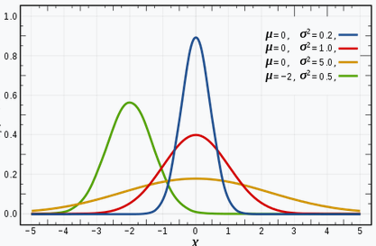
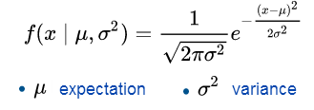
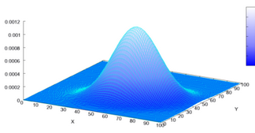
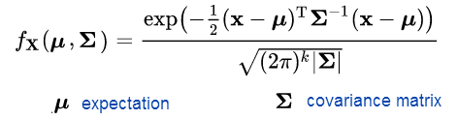
Prob. Estimation for continuous features
To apply Bayes’ decision theory, we have to find some way of modelling the distribution of our data. In the case of a continuous feature set we usually assume that the distribution can be described by some parametric curve. Using the normal (or Gaussian) distribution is the most common solution.
  Univariate Gaussian distribution
  Multivariate Gaussian distribution

Slide 9
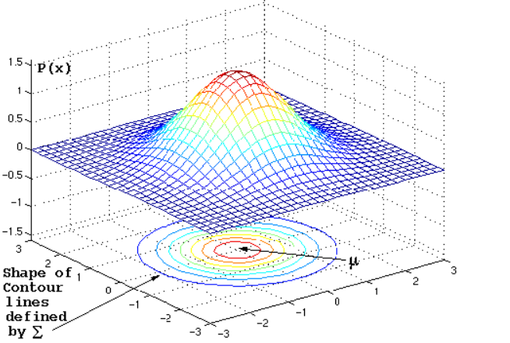
Covariance matrix - Examples
We will visualize 2D densities using their contour lines

Slide 10
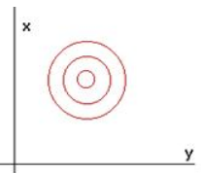
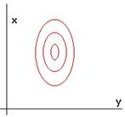
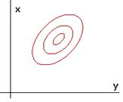
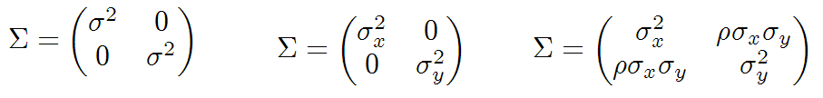
Covariance matrix - Examples
Diagonal covariance matrix with the same variance for both features
  The contour lines are circles
Diagonal covariance matrix with different variances
  Allows stretching the circles along the axes
Non-diagonal covariance matrix
  Allows both stretching and rotation

Slide 11
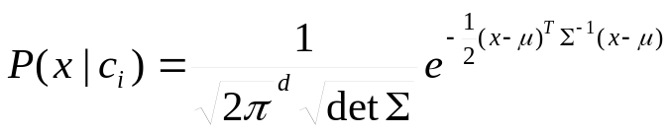
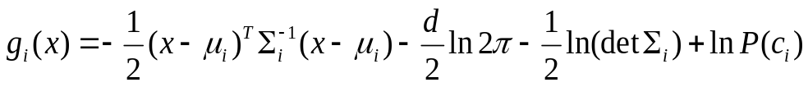
Decision boundaries for normal distributions
For simplicity, let’s assume that we have only two classes
Let’s also assume that they can be described by normal distributions
The decision rule requires P(c_{i}|x)=p(x|c_{i})P(c_{i})/p(x)
  Here p(x) is constant for a given x, so it does not influence the maximum over i
  The same is true for taking the logarithm
  So we can use the discriminant function g_{i}(x)=ln(p(x|c_{i})P(c_{i}))
  where
  Putting it all together gives

Slide 12

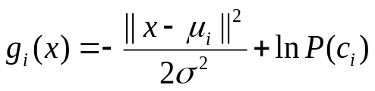
Special case #1
Let’s assume that Σ_{i}=σ²I for both classes
Then
  We can discard:
  - det Σ_{i} , as it is the same for both classes, it does not influence the decision
  - -d/2 ln 2π is a constant, it does not influence the decision
  The remaining component reduces to:
  As σ² is independent of i, the disciminant function is basically is the euclidean distance to the mean vector of the classes

Slide 13
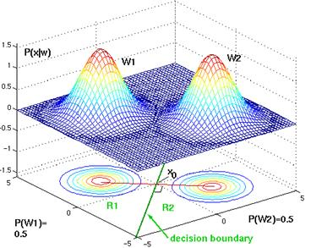
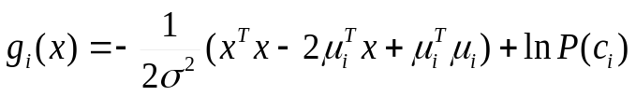

Special case #1
How does the distributions and the decision surface look like in 2D?
Decomposing the discriminant
functions, we get that
  As x^{T}x is independent of i, we
  can drop it. Then we get
  This is a linear function of x, which
  means that the discriminant functions
  are hyperplanes, and the decision
  boundary is a straight a line
  We will discuss the role of P(c_{i}) later

Slide 14
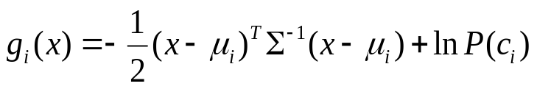
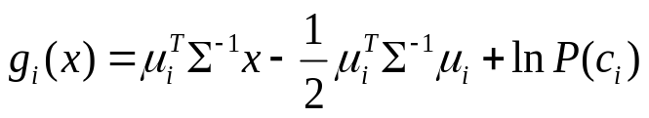
Special case #2
Σ_{i}=Σ, so the classes have the same (but arbitrary) covariane matrix
  Discarding the constans, the discriminant function reduces to
  The first term is known as the Mahalanobis distance of x and μ_{i}
  Decomposing the formula, we can drop x^{T}Σ⁻¹x as it is independent of i
  So we get
  This is again linear in x, so the discriminant functions are hyperplanes, and the decision boundary is a straight a line

Slide 15
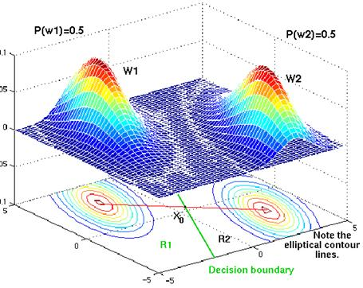
Special case #2
Illustration in 2D

Slide 16
General case
The covariance matrices are different, and may take any form
In this case we cannot reduce the discriminant function, it remains quadratic
in x. The decision boundary may take the shape of a conic section (line, circle, ellipsis, parabola or hyperbola).
Recommended reading: https://www.byclb.com/TR/Tutorials/neural_networks/ch4_1.htm

Slide 17
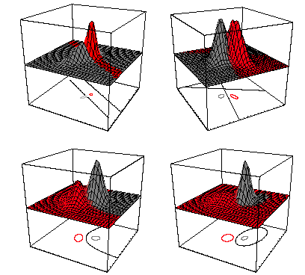
General case – examples 1

Slide 18
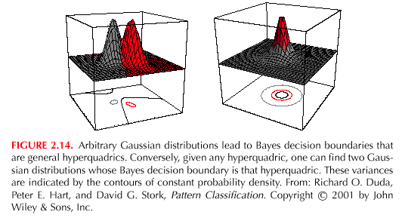
General case – examples 2

Slide 19
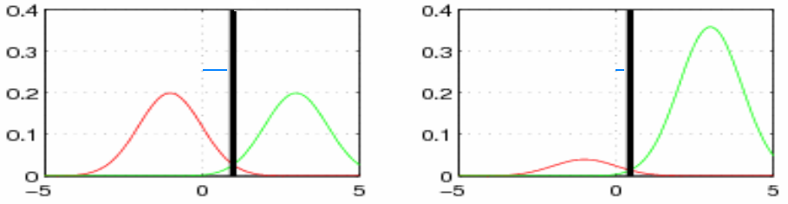
The effect of the class priors
How does the decision boundary change if we change P(c_{i})?
  g₁(x)=p(x|c₁)P(c₁) g₂(x)=p(x|c₂)P(c₂)
  Don’t forget that P(c₁) + P(c₂) =1
Changing the ratio of P(c₁) and P(c₂) equals to multiplying the disciminant functions by a constant
This will shift the decision boundary towards the less frequent class
  P(c₁) =0.5 P(c₂) =0.5 P(c₁) =0.1 P(c₂) =0.9

Slide 20
The naïve Bayes classifier
We examined how the decision surfaces look like for Gaussian distributions with given parameters
What’s next? We will assume that the samples in each class have a Gaussian distribution (true or not, see later…)
And we will estimate the distribution parameters from the data
  Our class distributions are of the form
  So the parameters we have to estimate are μ_{i} and Σ_{i} for is each class c_{i}
  Don’t forget that x is a vector, so we have to estimate the parameters of a multivariate distribution!
As it is not an easy task, we start with a simplified model
  This will be the naïve Bayes classifier

Slide 21
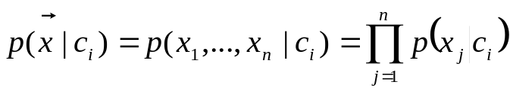



The naïve Bayes assumption
The naïve Bayes model assumes that the features are conditionally independent, so we can write
With this assumption, we have to estimate n 1-variable distributions instead of 1 n-variable distribution
  This is mathematically and technically easier
  For example we can use an univariate Gaussian distribution for a continuous feature
  And we can estimate μ by the empirical mean of the data items:
  and σ² by the empirical variance of the data over μ:
  (where D is the number of training examples)
  We will prove later that these formulas are correct

Slide 22
The naïve Bayes model
A big advantage of the naïve Bayes model is that can easily handle the case when the feature vector consists of both discrete and continuous features!
For the discrete features we can apply a simple counting-based estimation, remember the example:
  example:
  P(joint_pain=yes|infuenza=yes)≈2/3
  P(joint_pain=no|infuenza=yes)≈1/3
Fever | Joint pain | Cough | Influenza
38,2 | Yes | No | Yes
36,7 | Yes | Dry | No
41,2 | No | Wet | Yes
38,5 | Yes | Dry | Yes
37,2 | No | No | No

Slide 23
The naïve Bayes model
The third advantage of the naïve Bayes approach is that it is a very efficient tool against the curse of dimensionality
  It is very useful when we have few training samples and/or a lot of features
  Example: text classification with “bag of words” features
    e-mails-> spam/notspam
    Articles-> topic
    …
  We have to find some features that represent the text
    “bag of words” representation: the number of the occurrence of each possible word in the text
    Of course, the order of words is also important, but this is a very simple representation…

Slide 24

Example: the bag-of-words representation
This results if a HUGE feature space (100000 features)
For this task, any method other than Naïve Bayes is pretty difficult to use due to data sparsity (even if we have a lot of training data)

Slide 25
The naïve Bayes model - Summary
Advantages:
  Mathematical simplicity, easy implementation
  It can handle the mixture of continuous and discrete features
  Very efficient in handling sparse data (large feature space, few samples)
Disadvantage:
  Assuming feature independency is incorrect in most cases
In spite of this, the naïve Bayes approach is very popular and works surprisingly efficiently for many classification tasks

Slide 26
The sources of errors in statistical pattern recognition
In summary, creating a classifier by the statistical pattern recognition approach consists of 3 main steps:
  Select a suitable feature set
  Select a parametric model that we will use to describe the distribution of the data (when the features are continuous)
  Based on a finite set of training data, estimate the parameter values of the model
The errors of these 3 steps all contribute to the final error of the classifier
  Error = Bayes error + model error + estimation error
  What can we do about it?

Slide 27
The sources of errors in statistical pattern recognition
Bayes error: If the features do not fully separate the classes, the class distributions will overlap
  This will be present even if we perfectly know the distributions
  The only way to decrease the Bayes error is to select different features
Model error: For mathematical tractability, we must assume something about the shape of the distribution (e.g. it is a Gaussian distribution)
  The data rarely has this shape, there will be a mismatch – this is the error of the model choice
  This error can be decreased by choosing a better model
Estimation error: we have to estimate the model parameters from the training data set via some training algorithm
  This error can be decreased by using more training data and/or by refining the training algorithm

